Slide 1

Home Loan App to Predict Loan Approval
Alberto Medina; Pam Alhousseiny; Mason Plikerd; Parmeet Arora
Project 4 Proposal Team 1 ; 11-12-2024

Slide 2
Introduction
This project aims to develop a tool enabling users to input a variety of factors, including gender, marital status, dependents, educational level, loan amount, and more. ​
​
Subsequently, the tool will provide predictions regarding the approval of a home loan based on the entered parameters.

Slide 3
Data Source
Source: Kaggle – "Home Loan Approval" Dataset
Dataset Content:
Applicant demographics
Loan-related details
Link to Dataset: [https://www.kaggle.com/datasets/rishikeshkonapure/home-loan-approval?select=loan_sanction_train.csv]

Slide 4
Variables in the model
Gender: Applicant's gender, possibly influencing approval rates.
Marital Status: Relationship status as an indicator of financial stability.
Dependents: Number of dependents influencing financial obligations.
Education: Correlation with income and job stability.
Income: Primary factor for assessing repayment capability.
Loan Amount: Requested amount vs. applicant's profile.
Term of Loan: Duration, affecting monthly payments and risk.

Slide 5
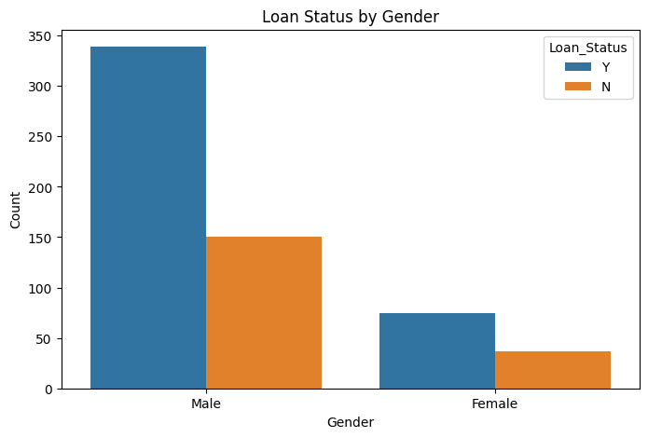
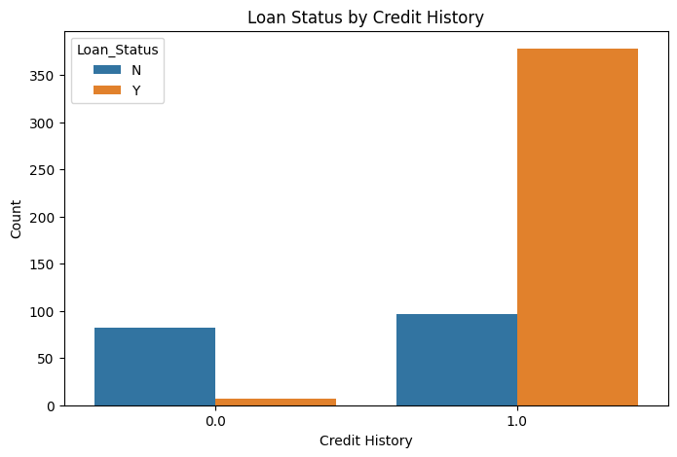
Overview of Training Data

Slide 6
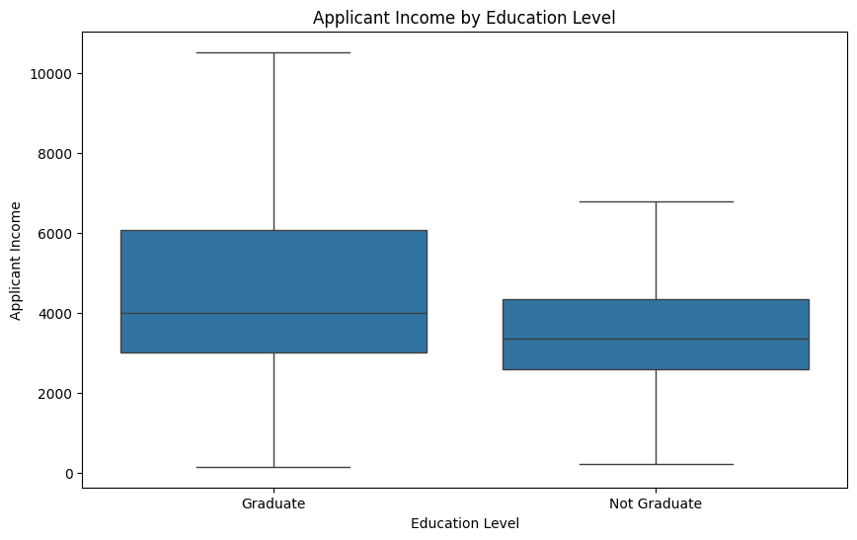
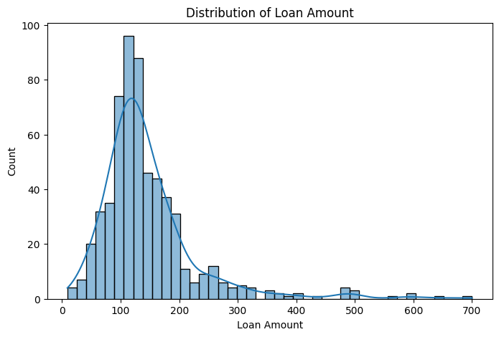
Overview of Training Data

Slide 7
Machine Learning Models
Algorithms:
Logistic Regression
Decision Trees
Random Forests
Objective: Identify the best-performing model for loan approval prediction.

Slide 8
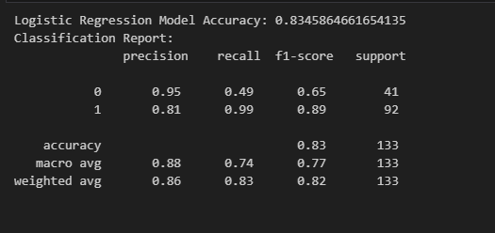
Logistic Regression Model
Logistic-Regression Model: accuracy 83%​

Slide 9
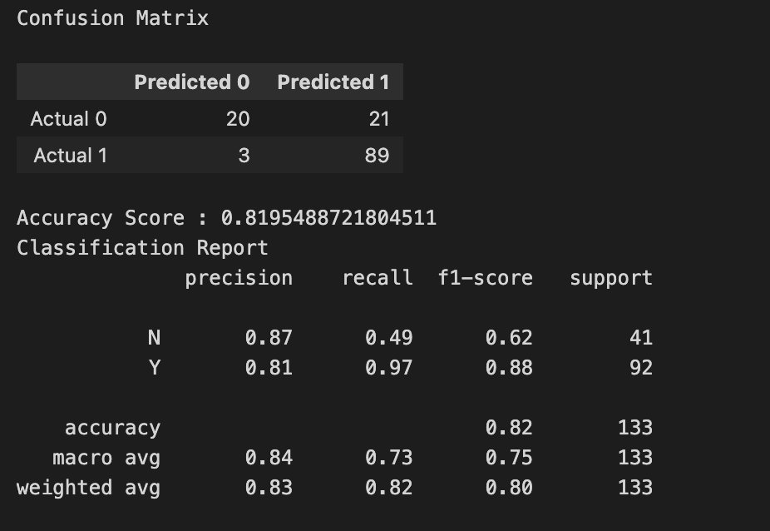
Random Forest Model
Random Forest Model: accuracy 81.95%​

Slide 10
Deep Learning Model
Deep Learning Model: accuracy 78%​

Slide 11
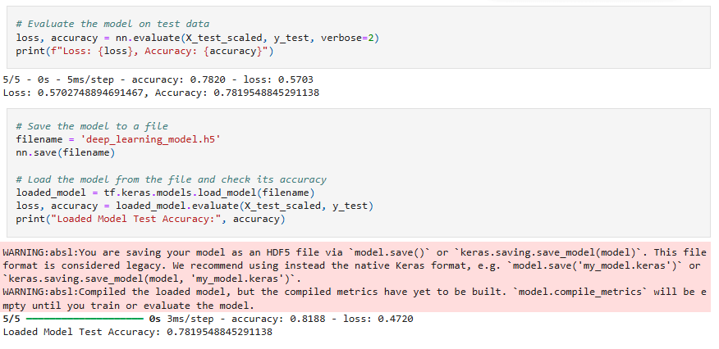
Machine Learning Models

Slide 12
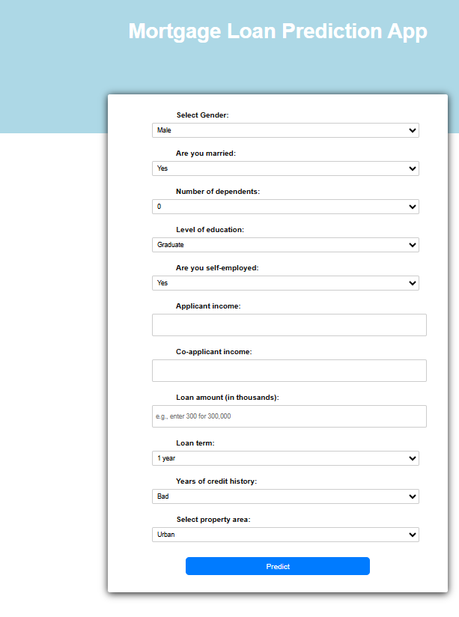
App Deployment

Slide 13
Expected Outcomes
Accurate Predictions: Reliable loan approval predictions for applicants.
Time Efficiency: Reduces loan processing time, aiding lenders.
Insightful Factors: Identifies key variables impacting loan approval for better decision-making.

Slide 14
Limitations
The project relies on the Kaggle Home Loan Approval dataset, which may lack certain relevant features that influence real-world loan approvals, such as credit history, employment length, or co-applicant details.
Overfitting risk is present, especially if the dataset is small or the model is too complex. This may cause the model to perform well on training data but poorly on new, unseen data.
The project requires computational resources for training and testing multiple models, which could be limited if the project team does not have access to high-performance computing resources.

Slide 15
Conclusion
Summary: A machine learning-driven Home Loan App to predict loan approval, leveraging insights from applicant data.
Benefits: Streamlines the loan process for lenders and provides borrowers with clear feedback on loan applications.

Slide 16
Questions & Discussion

